Slide 1




Market Assessment for Liquid Biofuels
This project has received funding from the European Union’s Horizon 2020 research and innovation programme under grant agreement No 727476.
COMSYN - Compact Gasification and Synthesis process for Transport Fuels

Slide 2




Introduction, scope and methodology
  COMSYN project
  Scope and methodology
Market outlook for advanced biofuels
  European Union biofuel status and targets
  Biofuel targets of European countries
  Biofuel targets in aviation and marine sectors
  Voluntary biofuel targets in private sector
  Biochemicals
  Barriers for advanced biofuels
Market assessment for COMSYN concept
  Biomass availability
  Refining FT product
  Competing technologies
  Prices for advaced biofuels
Summary and conclusions

Slide 3

1. Introduction, scope and methodology

Slide 4
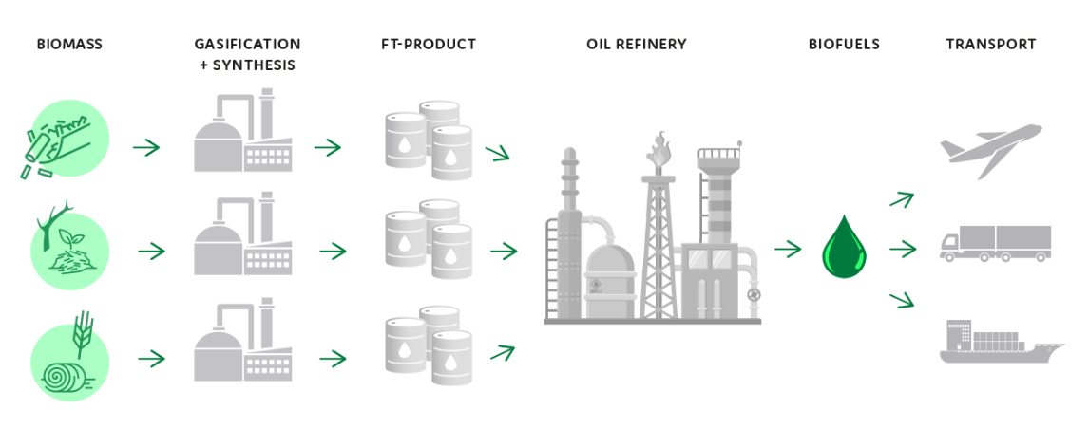
COMSYN project
COMSYN (Compact Gasification and Synthesis process for Transport Fuels) is an EU Horizon 2020 financed research project for development of a technology to produce advanced biofuels from solid biomass.
COMSYN project aims to bring the biofuel production costs down with intensified process technologies
The COMSYN process contains several steps:
  Gasification of biomass
  Cleaning of gasification gas to useful synthesis gas
  Conversion of gas stream to hydrocarbons with Fischer-Tropsch synthesis
  Upgrading the F-T product to transportation fuels in an existing oil refinery
COMSYN is an international project with partners from Finland (VTT Technical Research Centre of Finland, AFRY Finland), Germany (INERATEC, German Aerospace Center (DLR), GKN Sinter Metals Filters), Czech Republic (UniCRE) and Italy (Wood)
AFRY Finland is responsible for the market assessment on the end products (delivered to e.g. land, aviation and maritime transport) and the development of business concepts.

Slide 5
Scope and methodology of the market assessment
SCOPE
Assessing and identifying:
  Market and policy drivers,
  Market barriers, and
  Commercial potential of the biofuels.
Focusing on the market in North and Central Europe.
METHODOLOGY
Recent public policy reviews and other public market data
Public data by e.g. EU, IEA, Concawe, and IRENA.
Interviews of Central and North-European refining companies and companies active in biorefining conducted during 02/2018-03/2019
Inputs from project partners

Slide 6

2. Market outlook for advanced biofuels

Slide 7
EU biofuel status
Total energy consumption in the transport sector, 325 Mtoe in 2019, corresponds to 31 % of the final energy consumption in the EU.
Consumption of biofuels for transport, around 17 Mtoe in 2019, corresponded to 5.4% of total fuel consumption in EU transport sector (8.9% with multipliers). EU targeted to reach 10% by 2020.
Advanced biofuels consumption was 4 Mtoe i.e. 1.2% in 2019 (~80% produced from UCOs and animal fats)
Production of all biofuels was 16 Mtoe and installed production capacity 35 Mt in 2019
Figure: Consumption of liquid biofuels in EU28 in 2009-2019. Source: European Commission, DG ENER, Unit A4, 2021

Slide 8
EU biofuel targets defined in REDII
Decarbonisation of the EU transport sector will be gained through fuel efficiency, electrification, and sustainable biofuels
The renewable energy directive II (REDII) objectives by 2030:
  32 % of renewable energy in the Union's gross final energy consumption.
  14 % of renewable energy in the transport sector
    Aviation and maritime sectors can opt in to contribute to the 14% transport target, but there is no obligation
Binding target for advanced biofuels: the share of advanced biofuels and biogas produced from feedstocks listed in Part A of Annex IX at least 3.5% by 2030;
  Double-counting applied i.e. actual target share is 1.75%
  Intermediate goals 0.2 % by 2022 and 1 % by 2025 (includes double counting)
  Raw materials e.g. algae, forest residues, straw, wastes, manure, sludges, etc.
Cap of 7% for food and feed based biofuels (1st generation biofuels)
Cap of 1.7% for advanced biofuels produced from feedstocks listed in Part B of Annex IX i.e. UCOs and animal fats

Slide 9
EU advanced biofuel consumption by 2030
EU members assume a demand for advanced biofuels from Part A feedstocks 8-10 Mtoe to reach the REDII targets
Several international organisations and research institutes have estimated demand for advanced biofuels in Europe to reach 10-30 Mtoe by 2030
IEA scenarios show biofuel potential of up to 70 Mtoe/a by 2040
Additional production capacity is needed to reach the REDII target for advanced biofuels
  10 Mtoe equals to approximately 100 production plants with annual capacity of 100 kton/a each
  Currently projects under development for 11 Mtoe capacity and approximately half of them are based on feedstocks of part A
  Fuels Europe predicts biofuel production from lignocellulostic feedstocks to reach 4 Mt by 2030 representing EUR 25 billion investments
After 2030 demand of biofuels is estimated to increase but with slower phase due to development of electrification of transport
On a global level IEA estimats demand of 300 Mtoe to be on track with Sustainable Development Scenario
Figure: Estimates of advanced biofuel consumption
Sources: IEA, USDA/FAS, SGAB, DG&RI Ecosys, Fuels Europe, Concawe, national energy and climate plans of EU member states, CIT Industriell Energi AB, Pöyry, AFRY

Slide 10
Biofuel targets and plans of selected European countries
In Finland blending obligation for biofuels is 18% of energy content of sold (land) transport fuels including blending obligation of 2% for advanced biofuels. Obligated share of advanced biofuels will increase gradually to 10 % by 2030 (total share of biofuels 30%). No double counting is applied. Estimated demand for advanced biofuels is 500 ktoe in 2030.
Sweden targets to 70% of CO₂ emission reduction in the transport sector by 2030 compared to 2010. Liquid biofuel consumption is estimated to increase by 260 ktoe to 1.7 Mtoe by 2030. Advanced biofuels obtain CO2 tax exempt and there is an obligation to reduce fossil fuel consumption in the transport sector.
In Germany, there are plans to fund the production of advanced biofuels and renewable electricity-based fuels. Also sub-quota for advanced biofuels will be introduced. Estimated demand for advance biofuels 1 Mtoe in 2030.
Existing gaps in research and development on innovative advanced biofuels (for instance, fuels made from straw) will be filled through projects and demonstration projects, to enable large-scale production in the medium term.
Czech republic estimates to use 313 ktoe of biofuels under Annex IV, Part A in 2030 (0 ktoe in 2020) of which 146 ktoe would be biodiesel from domestic agricultural inputs. There is an obligatory biofuel share for gasoline and diesel fuel introduced on the Czech market: 4.1 % by volume for gasoline and 6.0 % by volume for diesel. The fine for undelivered biofuel is CZK 40/l (approx. € 1.5/l)
The country plans a new support for biomethane to enable the targeted share of RES and advanced biofuels in the transport sector
Poland estimates to consume advanced biofuels or HVO 420 ktoe in 2030 and 490 ktoe in 2040. Poland targets to launch domestic production of second and third generation biofuels in response to the growing demand in the transport sector. Low-Emission Transport Fund is established to support the expansion of alternative fuels infrastructure and to build up a market for those fuels. Over the next 10 years, the fund will have financial means of ca. EUR 1.5 billion

Slide 11
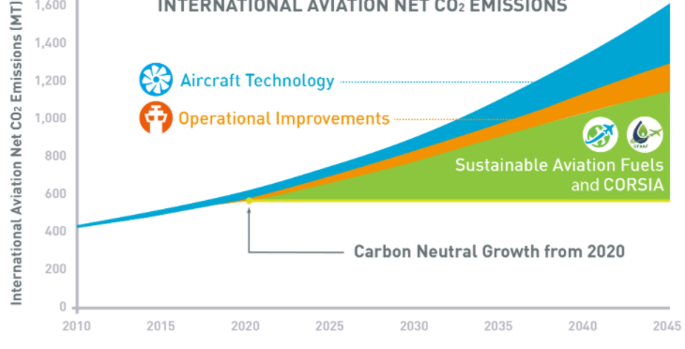
Biofuels in aviation sector
The production of sustainable aviation fuels is currently very small (0.1% of total energy consumption in aviation in 2018)
In the aviation sector there are no governmental policies to support biofuels due to the international nature of the sector
ICAO (an agency under the UN) and IATA (a trade association representing airlines) have set aspirational targets for emission reduction in aviation
  ICAO: Carbon neutral growth from 2020 onwards
  IATA: Stabilising net aviation CO₂ emissions at 2020 levels, reduction in net aviation CO₂ emissions of 50% by 2050 relative to 2005 levels
Measures for achieving the goals: 1) Aircraft technology and operational improvements; 2) Sustainable alternative fuels; 3) Market-based measures (CORSIA)
By 2040, fuel consumption of international aviation is projected to increase by 3-4 times compared to 2010.
  Sustainable jet fuels are required to achieve the industry’s emission reduction targets
  IRENA estimates that on quarter of CO₂ reduction could come from utilising biofuels and another quarter from synthetic fuels
IEA SDS requires 30 Mtoe biofuel consumption in aviation in 2030 and 60 Mtoe in 2040
Figure: Basket of measures to reduce aviation CO2 emissions (Source: ICAO, 2019)
Sources: IEA, ICAO (2016, 2019), IATA (2019), IRENA (2020)

Slide 12

Biofuels in marine sector
International shipping is estimated to have contributed about 2.2% to the global CO₂ emissions (source: IMO).
International Marine Organisation (IMO) has regulations for the emissions of air pollutants from ships
  The regulations are focused more on other pollutants (SOx, NOx etc.) than CO₂
  Mandatory energy-efficiency measures
IMO’s initial strategy on reduction of GHG emissions from ships
  Peak GHG emissions from international shipping as soon as possible
  Reduce the total annual GHG emissions by at least 50% by 2050 compared to 2008
  Pursue efforts to phase out carbon emissions, low-carbon and zero-carbon fuels are mentioned along with other measures
The biofuel market constituted by international shipping is rather limited on short to medium term
IEA estimates low-carbon fuels consumption of 7 Mtoe in 2030 and 26 Mtoe in 2050
Sustainalble development scenario would require consumption of 19 Mtoe and 123 Mtoe respectively
Sources: IEA, IMO (2020)

Slide 13

Voluntary biofuel targets in private sector
Emission reduction targets of some well-known European public and private companies were reviewed.
  53 companies from aviation, transportation, logistics, retail, consumer goods, and food sectors
Most companies aim at reducing their CO₂ emissions, or even becoming carbon neutral in the future.
  Measures differ (e.g. biofuels, electrification, hydrogen, natural gas, etc.)
Most airlines intend to increase the usage of biofuels in the future, but only a few have announced clear targets.
  Many airports have set ambitious targets (up to 100%) for their ground transport, especially in the Nordics.
In the transport and logistics sector, biofuels offer a short- and mid-term solution; electrification a long-term one.
Retail, consumer good and food sectors rely mainly more on other methods than biofuels for reducing their carbon emissions.
The biofuel market constituted by voluntary targets is rather small compared to the market set by regulations

Slide 14
Biochemicals
So far, there are no obligations for biochemicals usage
  It is however foreseen that the biochemical market will grow along with the biofuel market
Biochemical market is expected to be driven by consumer markets
  So far, only a few large players want to use bio-based plastics: e.g. IKEA, LEGO, Coca-Cola, Pepsi, etc.
  IRENA estimates demand for bioplastics to increase to 2.4 Mt/a by 2024 which is higher than current global production capacity but less than 1% of annual plastic production
  Large consumer brands with global presence that currently rely on single use plastics could play a major role in driving demand
According to IRENA, certification schemes, international standards and regulatory instruments would be needed to scale-up bioplastics demand and production and ensure utilization of sustainably sourced feedstock for bioplastics.
Naphta (C5-C12) and distillate (C11-C22) of FT-biocrude could suit for biochemical production (ethylene and propylene)
  FT feed might cause technical issues and require investments for pre-treatment at the refinery
From refinery point of view market for renewable products is not seen very attractive unless production costs decrease
Plastic recycling is currently a strong competitor for bio based solutions
  Many companies are investigating ways to use recycled instead of biobased plastic
Sources: with Central and North-European refining and biorefining companies (2018-2019), Neste Engineering/FlexCHX project (2019), IRENA (2020)

Slide 15
Barriers for advanced biofuels
Long investment cycles and high capital costs vs. regulatory uncertainty
  Recent changes in EU directives and national legislation
  Current levels of subsidies
  Concerns on stability/security of the industry
High production costs compared to fossil fuels and conventional biofuels
  Limited availability of low-cost raw materials
  Entire supply chain from feedstock to fuel needs to be developed to reduce the production costs
  Financing mechanism to bridge the gap between fossil and renewable fuels needed
Standards
  High fuel certification standards
  Lack of sustainable feedstock standards
Technology risks, especially related to first commercial plants
  Immaturity of technology
  Operational concerns and costs
Cost of capital and access to project financing
Competition with other methods of decarbonisation (e.g. electrification, hydrogen, natural gas, PtX, etc.)
Sources: IRENA (2019), Uslu et al. (2018), Concawe (2019), E4Tech (2017), Ecofys and Passmore Group (2015), AFRY

Slide 16

3. Market assessment for COMSYN concept

Slide 17
Availability of sustainable biomass
Sustainable biomass availability in 2020:
  Globally: 2 500 Mtoe/year
  Europe: 175 Mtoe/year
In 2020-2050, sustainable biomass availability is expected to increase continuously both globally (230-280%) and in Europe (130-310%)
  Globally, the increase is anticipated to be based on agricultural residues and energy plants.
  In Europe, agricultural residues, wastes and forestry residues are expected to contribute the most in terms of energy content.
Global trends of decarbonization & bioeconomy
  Different sectors are competing for the same sustainable biomass resources (transport, electricity, heating, industry, etc.)
  High cross-sectoral competition even at max levels of sustainable production.
Availability of sustainable biomass must always be studied locally
The COMSYN gasification methodology is suitable for all kind of wood residues, agricultural residues and waste-derived feedstocks which are available at a feedstock cost of 0-20 €/MWh.
  The COMSYN process is validated for wood residues and straw
  Wood based residues available in Northern Europe
  Wood based residues and straw available in Central Europe
Source: Concawe Review, 2019, AFRY, JRC, COMSYN project
Figure: Sustainable biomass availability 2020-2050 (Source: Concawe Review, 2019)

Slide 18
Refining FT product
FT syncrude currently competes with UCO, tall oil and vegetable oils as a feedstock for refineries
Suitability of bio-based FT-crude has to be evaluated case-by-case
  Technical feasibility and additional investments can vary considerably
FT syncrude is divided into three fractions: naphtha, distillate and wax
Naphtha part can be refined to gasoline without major investment needs
FT distillate can be a drop-in feedstock for oil refineries in small quantities (<5% of total feed) to produce diesel.
  Investments would be needed for larger quantities (isomerization)
FT distillate is a suitable feedstock for HVO plant to produce diesel and jet fuel
  Minimum techno-economic feasible amount of FT-biocrude to be co-refined in an existing refinery for HVO fuels was mentioned to be approximately 1/4th of total capacity of a refinery.
FT wax can be used in an oil refinery to produce transport fuels. It is also a good feedstock for production of base oils.
Oil refineries including a hydrocracking unit and having a HVO-refinery close by are seen attractive locations for FT syncrude refining.
  HVO-refineries could use the light fraction (approximately <C20) of FT-biocrude, but heavy fraction should be hydrocracked.
  Economic feasibility of the COMSYN concept would be challenged by the additional investment in a hydrocracker.
Sources: AFRY interviews with Central and North-European refining and biorefining companies (2018-2019), Neste Engineering/FlexCHX project (2019)

Slide 19
Competing technologies
Sources: COMSYN project; Concawe review, 2019.
ABF plants currently in operation are mainly based on hydrotreatment of fatty acids. Total installed ABF production capacity is 4.5 Mtoe/a.
Availability of low cost-raw materials for HVO fuels are limited and there is a need for new technologies to produce advanced biofuels
Different technologies are currently in pilot and/or demonstration phase. Issues to solve are e.g. high capital costs, technical issues related to process complexity and product treatment (pyrolysis)
ABF plants planned or under construction based on REDII, Annex XI, part A feedstocks
  8 plants based on gasification with a total capacity of 800 ktoe/a
  15 plants based on fermentation with a total capacity of 800 ktoe/a
  Plants based on hydrotreatment 4-5 Mtoe/a (3-4 Mtoe/a excluding PFAD)
  Planned plants based on part B feedstocks: 4-5 Mtoe/a
Sources: IRENA (2016, 2019), Concawe (2019), E4Tech (2017), CIT Industriell Energi AB (2020)

Slide 20
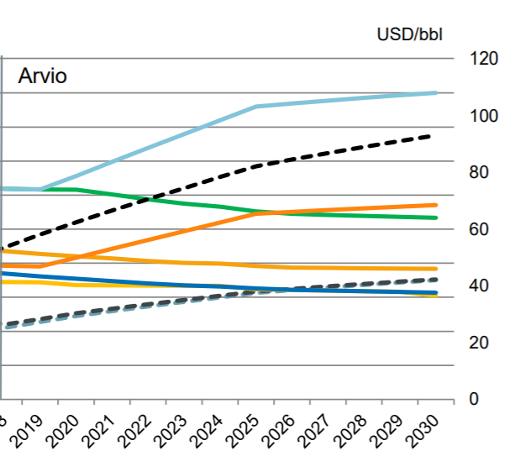
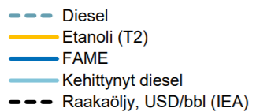
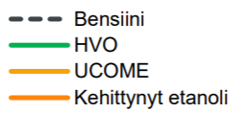
Estimated price of advanced biofuels
In general, biofuels will remain more expensive than fossil fuels unless the costs of mitigating climate change are going to be factored in the cost of fossil fuels
Production cost is mainly governed by the costs of feedstock and investments
Price of biofuels is determined based on tax extemts and sanctions related to biofuel obligations
  Some EU countries have set sanctions for missing the REDII targets; country specific sanctions vary from 0.5 €/ liter (Ireland) to 3.9 €/ liter (Hungary)
  UK blending oblication until 2032 and related certification scheme can be utilised to estimate the price of advanced biofuels
Envisaged lack of sufficient amount of production capacity for advanced biofuels to meet the REDII targets is estimated to increase the prices for advanced diesel and gasoline
Diesel
Ethanol (T2)
FAME (biodiesel)
Advanced biodiesel
Raw oil, USD/bbl (IEA)
Gasoline
HVO
UCOME (biodiesel)
Advanced bioethanol
Reference: Pöyry (Sipilä et al. 2018)

Slide 21
3. Summary and conclusions

Slide 22

Summary and conclusions
EU market for advanced biofuels is created by REDII regulation and national objectives by 2030
  Demand for advanced biofuels (from feedstocks of part A of REDII Annex XI) in the EU is expected to increase to at least 10 Mtoe by 2030. Higher scenarios envisage consumption of advanced biofuels of 20-30 Mtoe
High potential for biofuels in the aviation sector after 2030
  No near-term alternatives to liquid fuels
  Governmental policies for climate change prevention in the aviation sector currently missing, ICAO and IATA present aspirational targets
Global trends of decarbonization support utilization of advanced biofuels: consumption of biofuels need to increase to replace fossil fuels towards 2040 and 2050 to reach IEA sustainable development targets
The COMSYN gasification methodology is suitable for various kind of raw materials. Wood, straw and waste derived residues are estimated to be available at a feedstock cost of 0-20 €/MWh in Northern and Central European countries
FT syncrude is a suitable feedstock for refineries for production sustainable transport fuels
  Suitability to be assessed in more detail case by case
Advanced biofuels commercial development has been hindered by insecurities related to regulation, high capital costs and high production costs

Slide 23


Thank you!
This project has received funding from the European Union’s Horizon 2020 research and innovation programme under grant agreement No 727476.
More information on COMSYN project:
https://www.comsynproject.eu/
Contact:
Johanna Wahlström
johanna.wahlstrom@afry.com
AFRY Finland

