Slide 1




Business concepts for advanced biofuel production
This project has received funding from the European Union’s Horizon 2020 research and innovation programme under grant agreement No 727476.
Johanna Wahlström, Hannele Hakala and Mir-Ghaffoor Hejazi-hashemi, Afry finland

Slide 2



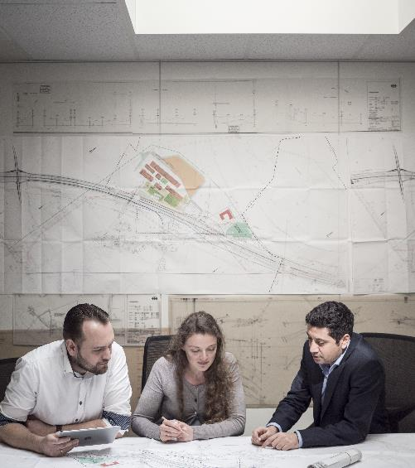
Introduction to COMSYN project
Current situation of advanced biofuels investments
Development of business concepts
  Northern Europe
  Central Europe
Economic performance and comparison of business concepts
Roadmap to commercial plant
Patent survey

Slide 3
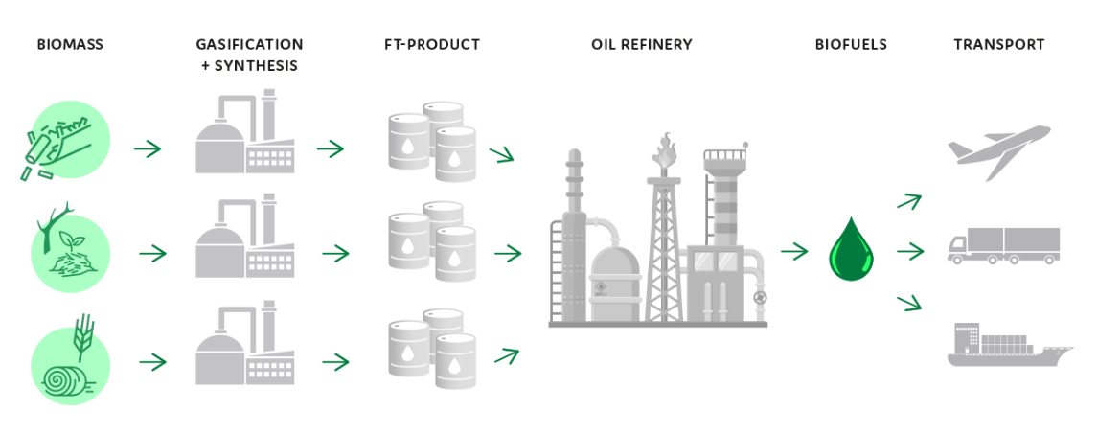







COMSYN project
COMSYN (Compact Gasification and Synthesis process for Transport Fuels) is an EU Horizon 2020 financed research project for development of a technology to produce advanced biofuels from solid biomass.
The COMSYN process contains several steps:
  Gasification of biomass
  Cleaning of gasification gas to useful synthesis gas
  Conversion of gas stream to hydrocarbons with Fischer-Tropsch synthesis
  Upgrading the F-T product to transportation fuels in an existing oil refinery
COMSYN is an international project with partners from Finland (VTT Technical Research Centre of Finland, AFRY Finland), Germany (INERATEC, German Aerospace Center (DLR), GKN Sinter Metals Filters), Czech Republic (Orlen UniCRE) and Italy (Wood)
AFRY Finland is responsible for the market assessment on the end products (for e.g. road, aviation and maritime transport) and the development of business concepts.

Slide 4
Current situation for advanced biofuels investments
Markets and regulation: lack of long term policy support and stability of market conditions
High production costs, lack of financial support to bridge the gap between fossil and renewable fuels
High capex and issues in availability of financing
Feedstock: local availability and price (availability of low cost feedstocks), development of supply chains
Sustainability criteria of renewable fuels (lifecycle GHG emission, direct and in-direct land use)
Standards, lack of harmonisation in certification of fuels
Lack of a decarbonisation driver and policies for aviation and marine fuels
Competition with other means of decarbonisation (e.g. PtX, hydrogen, electrification of transportation)
Market for advanced biofuels in EU created by REDII regulation
COMSYN project aims to bring the biofuel capital and production costs down with intensified process technologies:
  Development of key technologies
  Lower capex through technology selection and concept development
  Further efficiency improvements with optimal process configuration
  Dimensioning the plant according to local low cost feedstock availability
  Utilising opportunities to sell the excess energy as process steam or district heat
  Utilising existing oil refineries for product upgrading
Sources: IRENA (2016, 2019), E4Tech (2017), COMSYN project, Uslu (2018)

Slide 5
Strengths, weaknesses, opportunities and threats of biorefinery investments
STRENGHTS
Replacement of fossil fuels and reduction of CO₂ emissions
Adding value to sustainable use of biomass
No need for equipment changes (engines)
Energy security
OPPORTUNITIES
Contribution to sustainable development
Development of multipurpose biorefineries in a framework of scarce raw materials and energy.
Strengthening of the economic position of various market sectors (e.g., agriculture, forestry, chemical, and energy).
further a mixture of liquid biofuels, blended biofuels with conventional fuels,​
High oil prices (taxation)
WEAKNESSES
High capital and production costs
Most promising biorefinery concepts and value chains not clear
Policy uncertainty
Feedstock costs
THREATS
Cheap fossil fuels
Fluctuating long term governmental policies
Long term availability of feedstocks
Availability of capital
Unrealible delivery of end products
International development of a portfolio of other biorefinery concepts
Sources: De Jong, Jungmeier (2018), Renewable energy plicy network (2018)

Slide 6
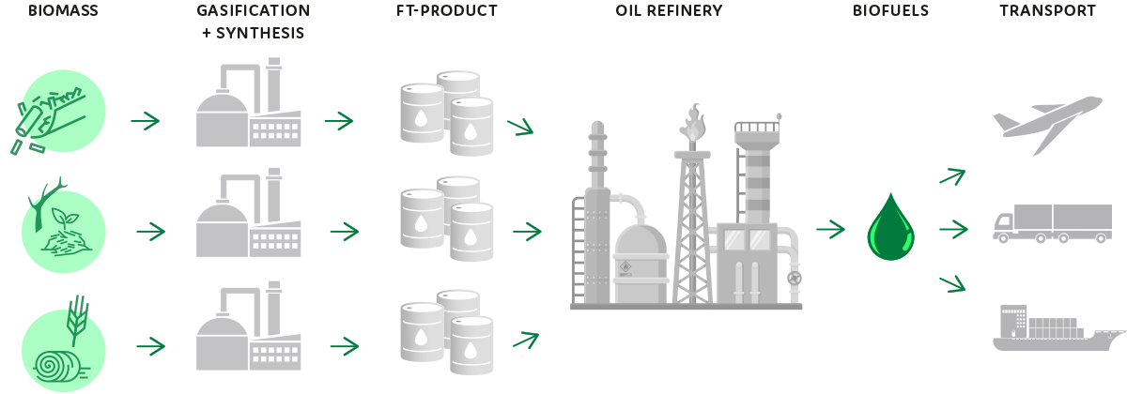
Development of the business cases for Northern and Central Europe
Business concepts
Definition of business cases in cooperation with consortium partners VTT, DLR, Wood and Orlen UniCRE
Selection and supply chain of raw materials
  Availability, price, technical suitability
Site location
  Logistics, distances, energy integration
  Prices for electricity and heat
FT transport and integration to the refinery
  Logistics, distances
  Technical suitability, co-processing, end products
Business concepts analysis was focused for FT biocrude production. Refining of the biocrude at an existing refinery is analysed by Orlen UniCRE in COMSYN project work package 4.

Slide 7
Business concepts for Northern Europe and Central Europe
Northern Europe
Feedstock: forest industry by-products, forest chips, demolition wood and SRF
Site location: forest industry sites (pulp mills and saw mills), cities with large DH demand
  Utilisation of feedstock available at industrial sites
  Utilisation of steam turbines at industrial sites for own electricity production
  Production of district heating for additional revenue
Biocrude upgrading: oil refineries with HVO units nearby can be found in Northern Europe (e.g. Finland, Sweden)
Central Europe
Feedstock: straw (also bark would be available)
  Plans/policies to increase the usage of straw for biofuel production
Site location: search for suitable location done taking into account feedstock prices and transport costs, revenue from heating sales, electricity costs and transport costs of biocrude
  Lowest production costs in Czech republic, Southern Poland and Western Slovakia
  More information regarding methodology and results of finding a suitable locations and estimating plant sizes ia available in COMSYN work package 6 prepared by DLR
Fossil fuels are currently used to large extent for district heating production and energy production for energy intensive industry in several countries
  Need for replacement investments
  Possibility for renewable heating sales
Selection of between DH/process heat production and maximising own electricity production depend on country specific and local heat and electricity market conditions
Product upgrading assumed at ORLEN Unipetrol refinery
Notes:
Countries included to the analysis were Germany, Poland, Czech republic, Slovakia, Austria, Hungary

Slide 8





FT production sites
- Northern European
0 / 9 MW
Electricity
Steam or electricity
80 MW
Forest industry by-products
15 €/MWh
Saw mill
FT + DH
28 kton/yr
FT-syncrude
18 MW
Electricity
150 MW
Demolition wood, forest chips, SRF
20 €/MWh
32/5 MW
District heating
City refinery
FT + DH
53 kton/yr
FT-syncrude
60 MW
District heating
Steam to electricity production
Oil refinery
200 MW
Forest industry by-products, forest chips
20 €/MWh
Pulp mill
FT + Gas
70 kton/yr
FT-syncrude
18 MW
FT-tail gas
Sources: VTT, AFRY, techno-economic modelling by DLR
Notes:
Saw mill: electricity can be generated with saw mill’s steam turbine and if such do not exist with own steam turbine. In case there is large enough heat demand in the local DH network only district heat could be produced from the excess process heat and electricity should be purchased from grid

Slide 9

FT production sites
- Central European
3 MW
Electricity
Electricity
200 MW
Straw
16 €/MWh
Utility/industry
FT + SC & DH
60 kton/yr
FT-syncrude
26 MW
Electricity
200 MW
Straw
16 €/MWh
Utility/industry
FT + DH
60 kton/yr
FT-syncrude
70 MW
District heating
96 MW
District heating
Oil refinery
Electricity
200 MW
Straw
16 €/MWh
Utility/industry
FT + SC
60 kton/yr
FT-syncrude
2 MW
Electricity
Sources: AFRY, Wood, techno-economic modelling by DLR

Slide 10
Assumptions for business concepts
 | NE: City refinery | NE: Pulp mill | NE: Saw mill (steam+DH) | CE: Utility 1 (Straw, DH only) | CE: Utility 2 (Straw, SC+DH) | CE: Utility 3 (Straw, SC)
Location country | FI / SE | FI / SE | FI / SE | PL / CZ | PL / CZ | GE
Feedstock price*(€/MWh) | 20 | 20 | 15 | 19 | 19 | 18
District heat sales (€/MWh) | 30 | - | 30 | 34 | 34 | 32
Purchased / sold electricity (€/MWh) | 60 / - | 60 / - | 60 / - | 70 / - | 70 / - | - / 80
FT tail gas sales (€/MWh) | - | 30 | - | - | - | -
Capex**(M€) | 241 | 281 | 151 | 296 | 337 | 329
Fixed operational costs (M€/a) | 14 | 16 | 9 | 16 | 18 | 18
Variable operating costs, excl. feedstock and power (M€/a) | 11 | 14 | 8 | 16 | 16 | 16
*incl. trasportation costs
** incl. spare parts, excl. land and grid connection costs
Sources: DLR, Wood, VTT, AFRY

Slide 11
Competitiveness of business concepts
The competitive price of Fischer-Tropsch biocrude is estimated to be currently 0.9-1.1 EUR/kg (competition with HVO feedstock prices utilising mainly feedstocks of REDII Annex IX, part B)
Advanced biofuel prices are estimated to be in the level of 1.5-2.0 EUR/kg depending on development towards EU targets
  Refinery costs are estimated to 0.2-0.3 EUR/kg
  FT biocrude price should be below 1.2-1.7 EUR/kg
Pulp mill and city refinery cases are the most profitable concepts
  Economy of scale, energy sales and utilising existing steam turbine enable better economic performance
Large Northern European cases utilising wood based residues have better economic performance compared to Central European cases utilising straw
  Viable business concepts can be found with both feedstocks depending on WACC
Investment or production subsidies needed in order to ensure economic feasibility of the biocrude production
Notes:
Low prices secure payback for investors for the best business cases but EU targets are not reached
Higher prices refer to high competition of biofuels due to strict economic sanctions for missing the EU targets and slowness of building new advanced biofuel capacity
None of the business concepts are competitive with the current feedstock prices without some kind of support
Saw mill has slightly better result if all heat could be sold as DH, investing in own ST increases the price of biocrude

Slide 12
NPV and IRR of business concepts
Assumptions: 10% WACC, FT biocrude price 1.5 EUR/kg (advanced biofuels price 1.8 EUR/kg)

Slide 13
Biocrude price with investment support
WACC=7%
WACC=12%
Notes:
Investment support of 30-40%, even 50% can be estimated to be available for new technology investments that support national and EU level renewable energy goals
Investment grand of 50 % would make the Northern European cases profitable (WACC 12%)
Also straw cases with district heat sales could be able to produce biocrude with competitive price and be profitable
With 7% WACC and 50% investment support all cases would be able to produce biocrude with competitive price exept straw with only power production

Slide 14
Biocrude price with different feedstock prices
WACC=7%
WACC=12%
Notes:
No investment support included to the analysis

Slide 15
Roadmap to commercial plant investments
Pilot (TRL5) - COMSYN 2017-2021
Demonstration (TRL6-7) 2022-2025
First commercial plant (TRL8-9) 2026->
Several commercial plants 2030s
Notes:
Current status:
Development of key technologies and processes to TRL 5
Validation of the whole process with diverse feedstocks
Process modelling, evaluation of process configurations, case studies
Successful studies and experimental tests on Biomass to Liquid have shown that the technology for production of Advanced Fuels is already developed to such state of the art that full-scale production of Advanced Fuels is only a matter of economy of scale and courage to invest in production plants,
Next, demonstration plants are needed to be built in different kinds of environments with different biomass feedstock availability. These demonstration plants would need research support for investment and operation to be economically viable. Success of the demonstration plants together with regulatory support would encourage the market and investors to start large-scale production and distribution business
Demonstration phase: 2-3 years
Years shown in the graph are indicative, Time is also needed for financing, contracting, engineering and construction between the phases

Slide 16
Possibilities for demonstration
Industrial demonstration
Location at industrial site with a possibility to utilize the gasification gas in a boiler or an industrial kiln
  Gasification and hot filtration capacity 10-50 MW
  1-5 MW slipstream extracted for gas cleaning and synthesis demonstration
  After demonstration period, operation of gasifier would continue at the site replacing fossil fuel based production
Demonstration cost is estimated to 30-60 M€
  Major part of the investment can be realized as a commercial project to replace fossil fuels. Also investment support for fuel switch could be received.
  Low technology risk for the industrial site: gasifier can be converted to air-blown CFB gasifier, which is a commercially proven technology after demonstration phase
  Size enables scaling up to 100-150 MW
  The total investment for demonstration is reasonably low as the final gas cleaning and synthesis is demonstrated at a smaller scale.
  Possibility for demonstration financing and investment grands
Demonstration at VTT Bioruukki facilities
VTT is able to construct and operate a small semi-industrial demonstration plant with 1-2 MW input capacity
Demonstration cost for two years is estimated to 15-25 M€
Possibility to research and demonstration funding. Industrial partners could take part in the project individual shares of
1-5 M€
Complete production concept would be demonstrated as an integrated plant for about 5000 hours
  District heat production
  200 t of F-T products to refinery for final refining tests
The small scale enables testing and further development of various process alternatives
Scaling up to 100-150 MW challenging from a small unit
There is also a possibility to find separate demonstration applications for the individual key technologies.
Notes:
The size is sufficiently large for follow-on scale-up to 150 MW
The demonstration can be divided into two or more projects, which may have different financing structures (combination of investment and demonstration funding)
Demonstration project barriers
Funding for project development and technology development
Public sector funds
Governmental or EU level research and innovation agencies funds
Public sector loans to lower investment risks
Public and private sector partnership
Commercial aspects: market access, infrastructure, fuel standards
Strategic partnerships across the supply chain

Slide 17
Patent survey
Patent survey was conducted to find out any obstacles in commercialisation of the developed technology
Survey was focused on biomass gasification using Fischer-Tropsch and Dual Fluidized Bed methods
Survey included patents are articles after 2008, total 1199 patent applications and publications
  DFB gasification: 24 patents, F-T 250 patents
The study gives a general view on main players, geographical areas, examples of patents and scientific publications.
The patents related to Fischer-Tropsch are related to specific details of process configuration -> not seen as an obstacle for commercialisation of COMSYN concept
Dual fluidised bed gasification patents are mainly owned by Chinese companies -> these are not seen very relevant for the European cases, however, the development of the patents in Europe should be followed
Figure shows combined outlook of patents (brown) and publications (green)
Source: Caplus database/STN AnaVist, 1199 patentapplications and publications filed in 1/2008-1/2021

Slide 18

Summary and conclusions
Business concepts based on wood based residues and straw were identified and studied
Northern European cases were found to be more feasible in economic terms compared to Central European cases
  Economy of scale and possibility to use existing steam cycle
Viable business cases can be found in Northern and Central Europe with some investment support
Securing the low cost feedstock and revenues from heat or gas sales are important for successful business case
Demonstration of the process is the next step towards commercial production of advanced biofuels
Success of the demonstration plants together with regulatory support would encourage the market and investors to start large-scale production

Slide 19


Thank you!
This project has received funding from the European Union’s Horizon 2020 research and innovation programme under grant agreement No 727476.
More information on COMSYN project:
https://www.comsynproject.eu/
Contact:
Johanna Wahlström
johanna.wahlstrom@afry.com
AFRY Finland

